Slide 1
x
1
4
3
-1
2
-4
1
0
2
-1
w
1
2
1
x
1
4
3
-1
2
-4
1
0
2
-1
w
1
2
1
x
1
4
3
-1
2
-4
1
0
2
-1
w
1
2
1
x
1
4
3
-1
2
-4
1
0
2
-1
w
1
2
1
u

Slide 2
x
1
4
3
-1
2
-4
1
0
2
-1
w
1
2
1
x
1
4
3
-1
2
-4
1
0
2
-1
12
9
3
-1
-5
-1
3
3
w
1
2
1
u = x * w
x
1
4
3
-1
2
-4
1
0
2
-1
w
1
2
1

Slide 3
x
w₁
w₂
w₃

Slide 4
x
Uniform filter
(moving average)
Gaussian filter
u
u

Slide 6
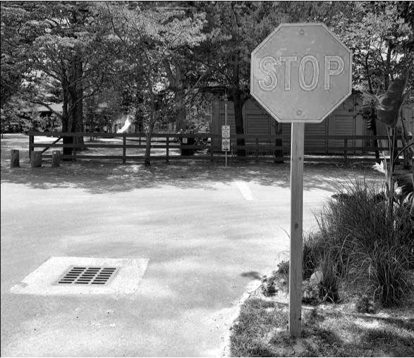
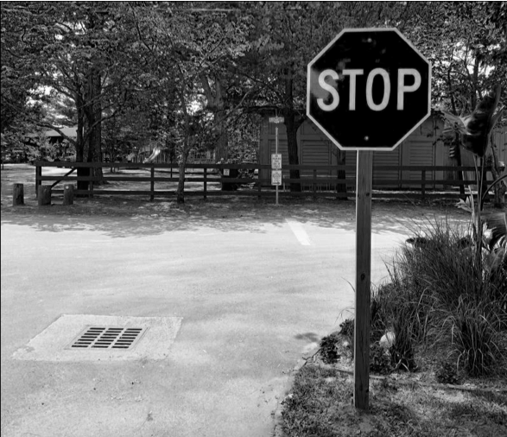
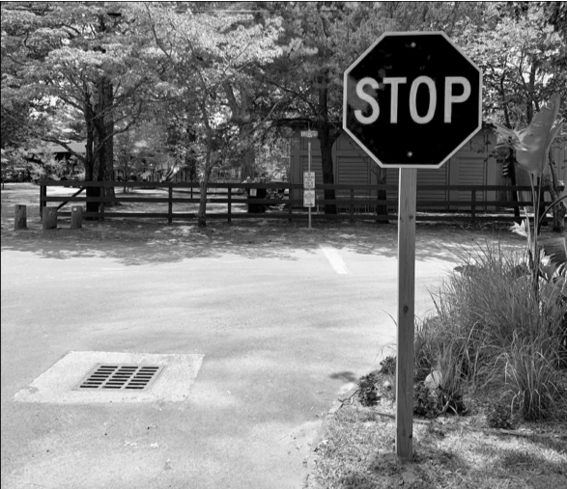
red channel
flatten
blue channel
green channel

Slide 7
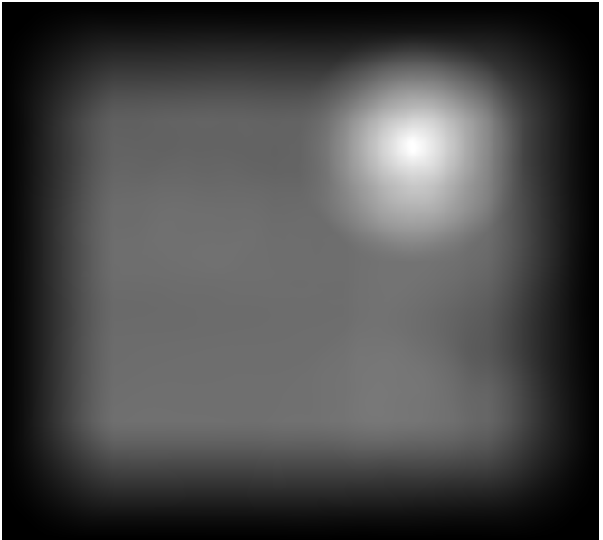

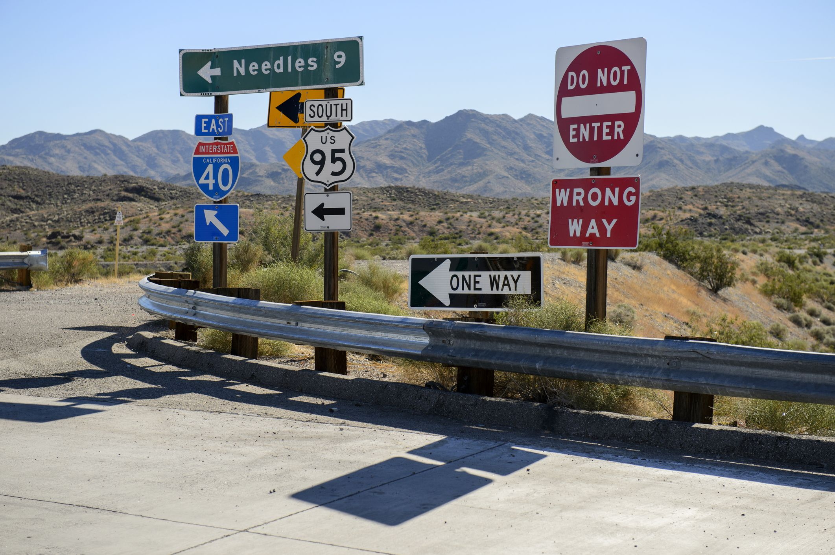
*
w
x₁
*
w
x₂

Slide 8





Slide 9
T
w
x
T
T
T

Slide 11
u₁
u₂
u₃
...
w₁
w₂
w₃
...
*
=
x

Slide 13

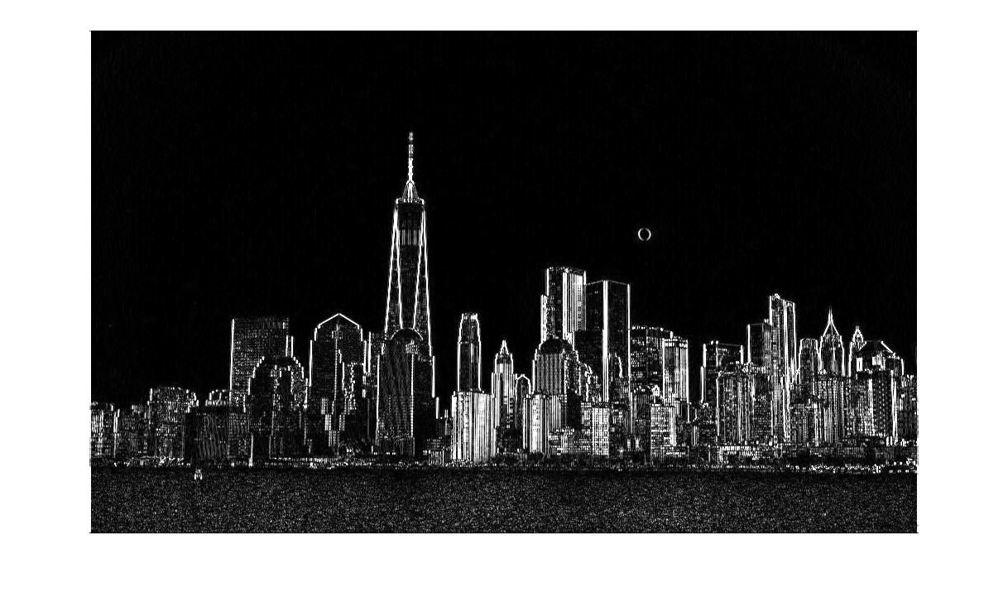
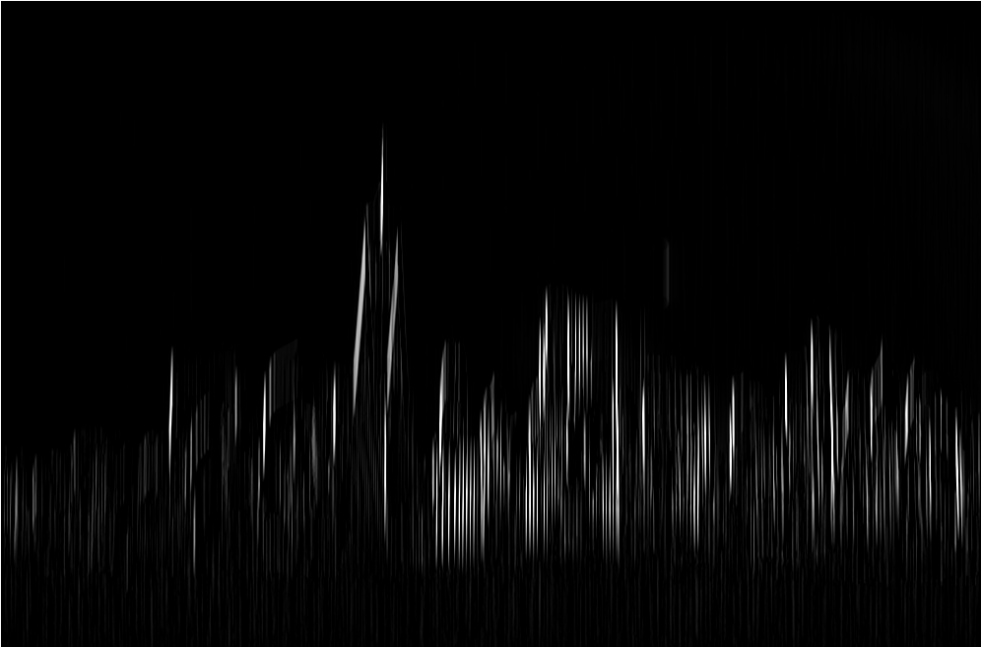
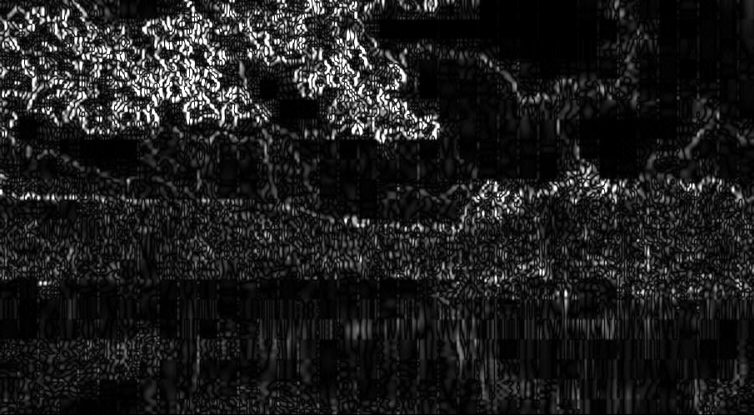
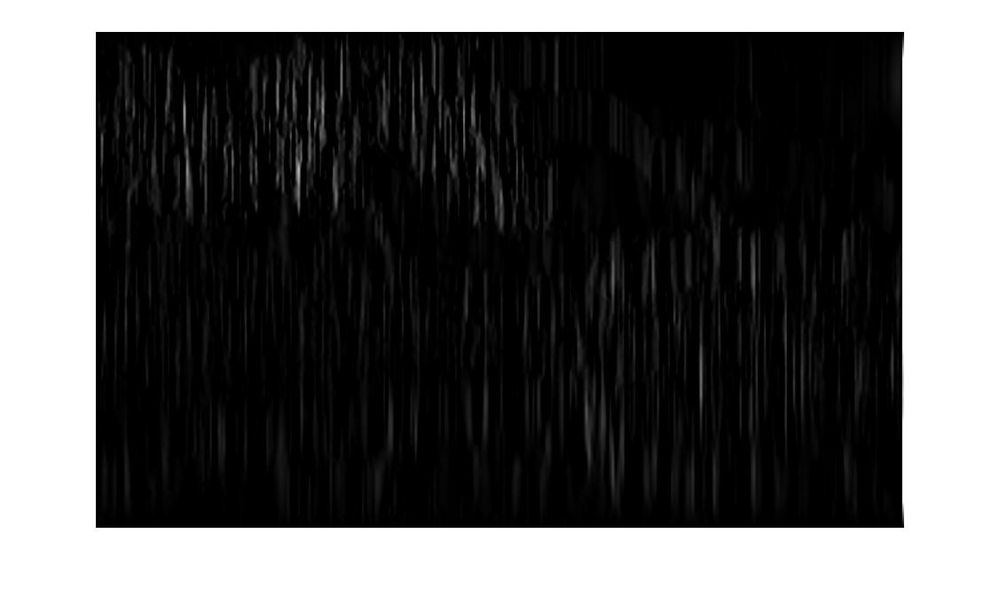
*
E_{C}
E_{C}
V_{C}
*
E_{L}
V_{L}
E_{L}

Slide 14
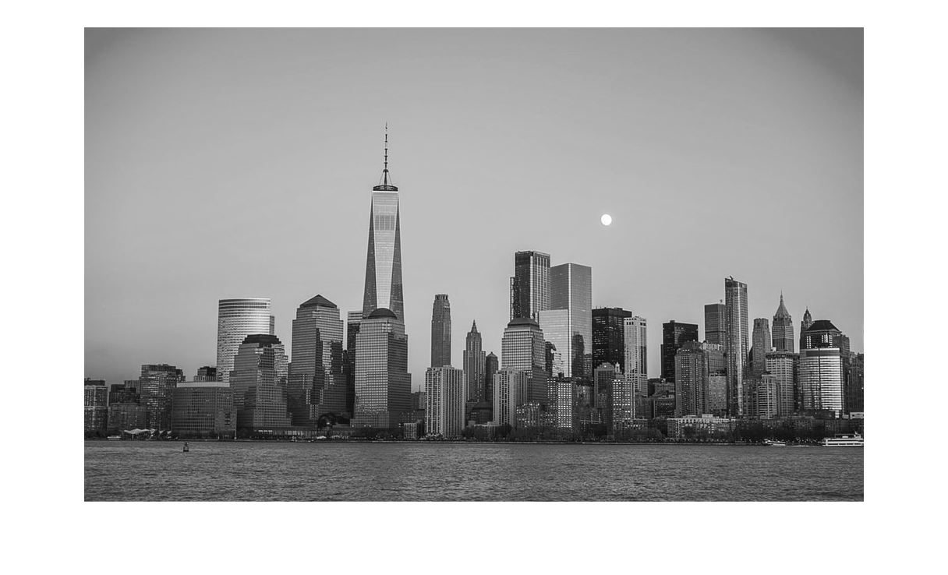
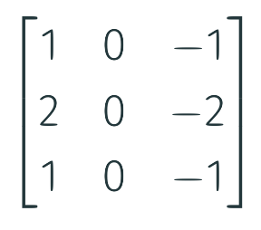
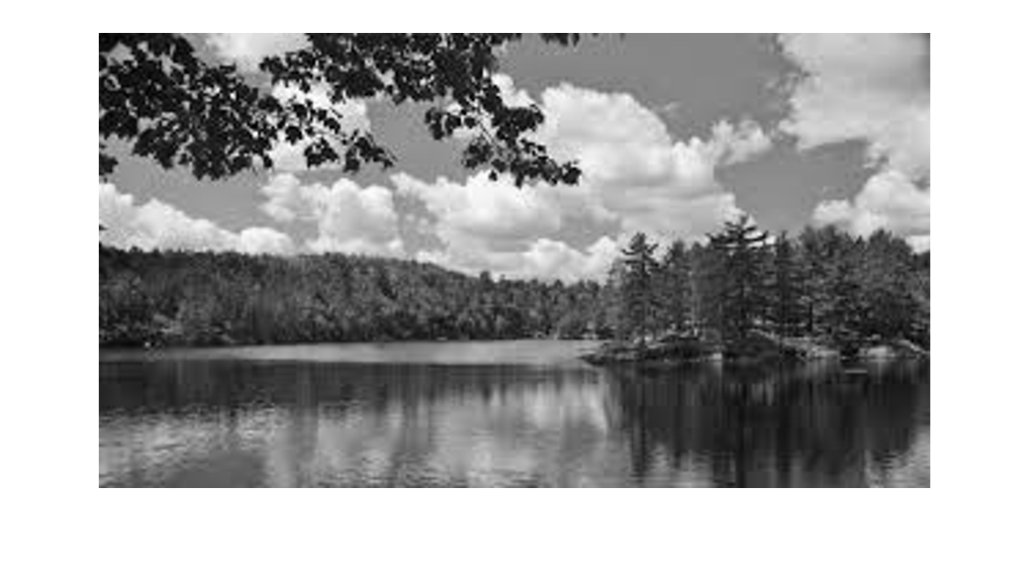
*
*
mean(V_{C})
I_{C}
E_{C}
V_{C}
*
*
mean(V_{L})
I_{L}
E_{L}
V_{L}

Slide 15
c
f
a
d
g
z
b
e
h
layer 0
layer 1
layer 2
layer 3

Slide 16
class 1
z
class 2
x₁
x₂
class 3
input layer
class 4
hidden layer
output layer

Slide 17
class 1
_
z
u
class 2
x₁
x₂
class 3
input layer
class 4
hidden layer
batch normalization layer
output layer

Slide 18
class 1
_
z
u
class 2
x₁
x₂
class 3
input layer
class 4
hidden layer
batch normalization layer
output layer

Slide 19
class 1
_
z
u
class 2
x₁
x₂
class 3
input layer
class 4
hidden layer
batch normalization layer
output layer

Slide 20
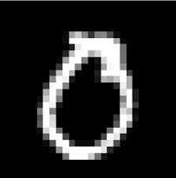

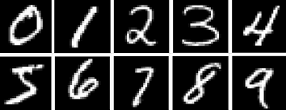
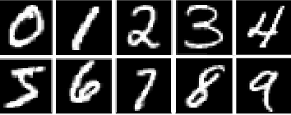

Slide 21
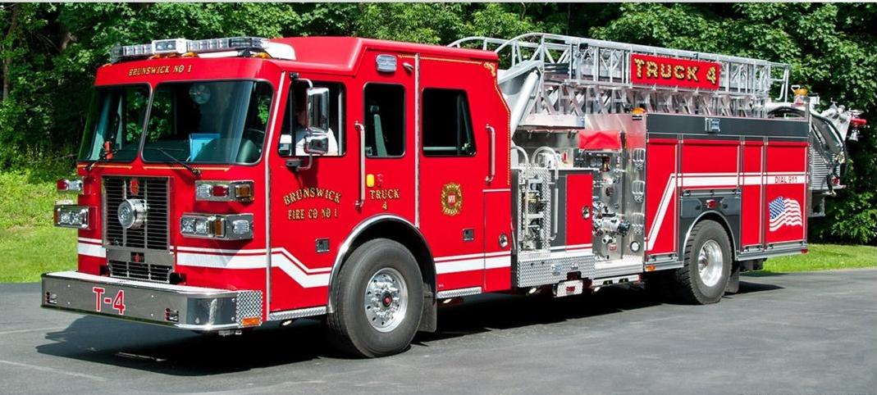


Slide 22
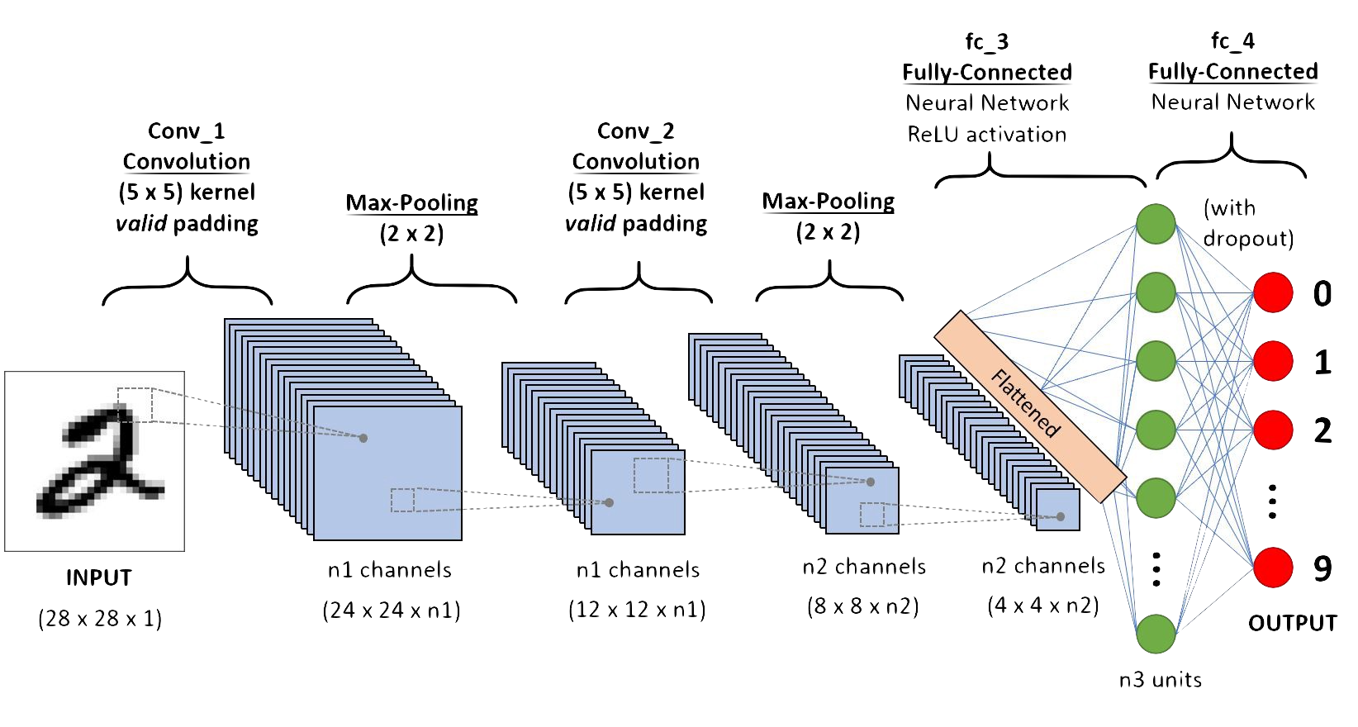
red channel
blue channel
green channel
= -1
= 0
= 1

Slide 23
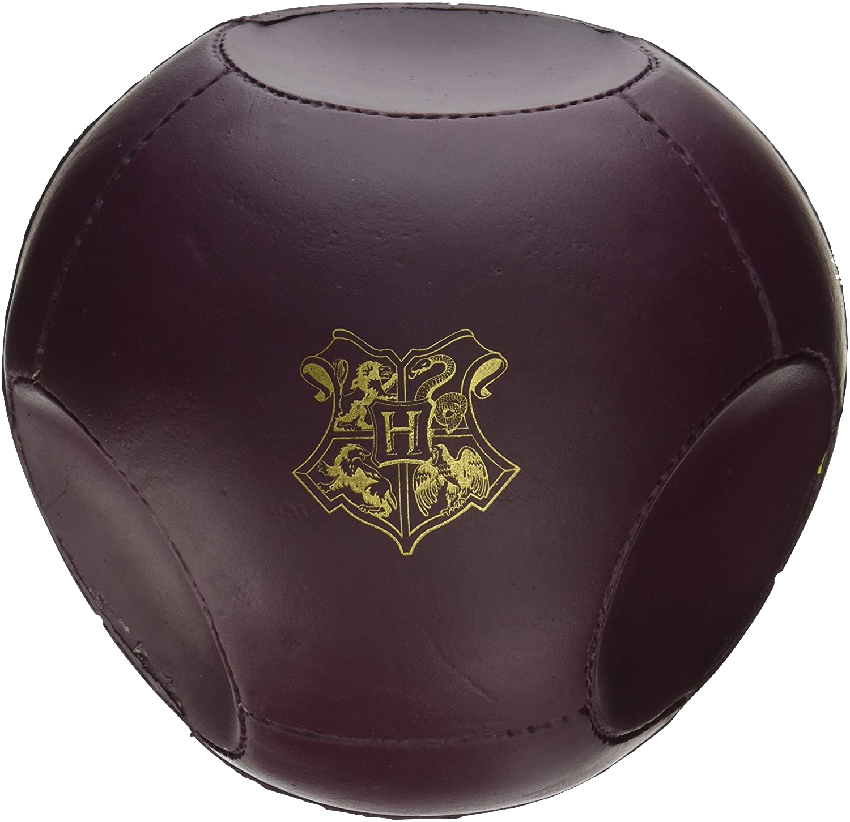
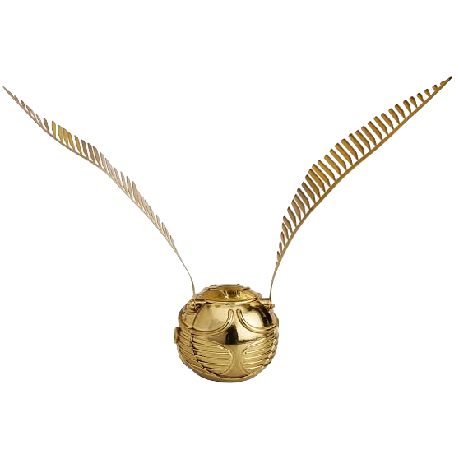
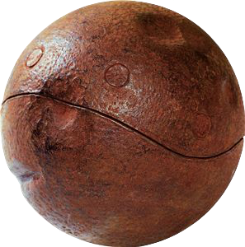
quaffle
bludger
snitch

Slide 26
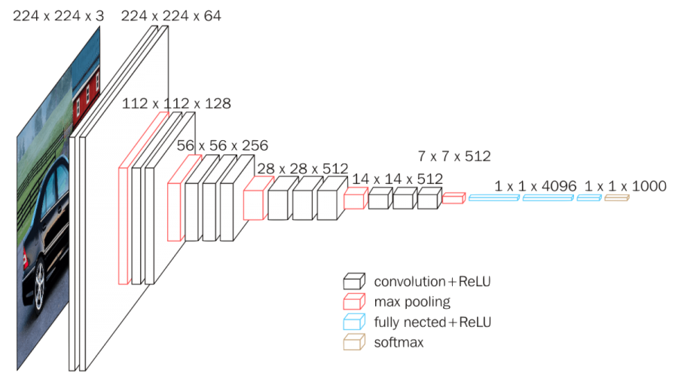
low-level features
high-level features
x ∈ℝ^{d}
z ∈ℝ^{k}
y ∈ℝ

Slide 27
Classes
1 | .1 | 1 | .6 | 1 | .4
10 | 7 | 2 | 7 | 5 | 1
.2 | .1 | 1 | .1 | 0 | .9
roundness
size relative to human hand
Features
yellowish color

Slide 28

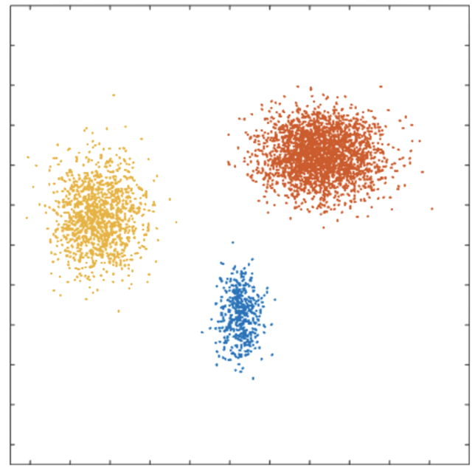
yellowish color
roundness

Slide 29
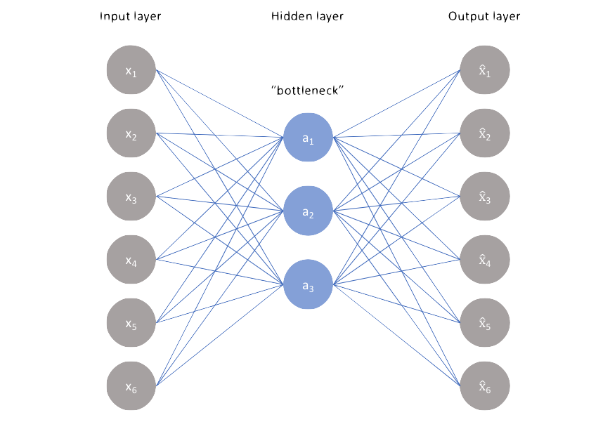
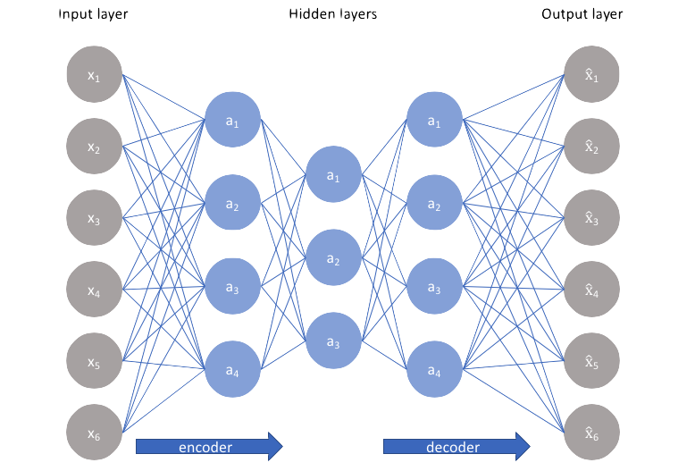
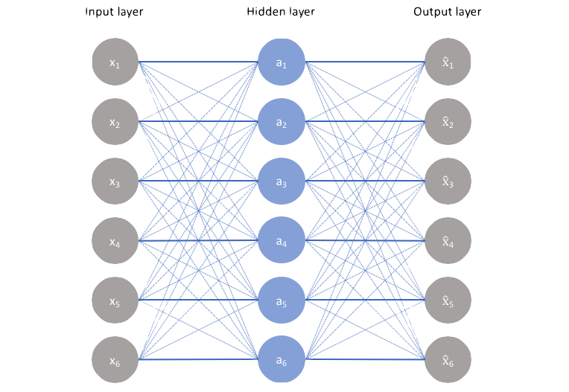
compressed representation
Z₁
Z₁
Z₂
Z₂
Z₃
learned
features
Z₃
Encode e
Decode d

Slide 30
Space of all images
𝓐
Space of images representable by autoencoder
projection f(x)
𝒮
Space of natural images
ℐ

Slide 31
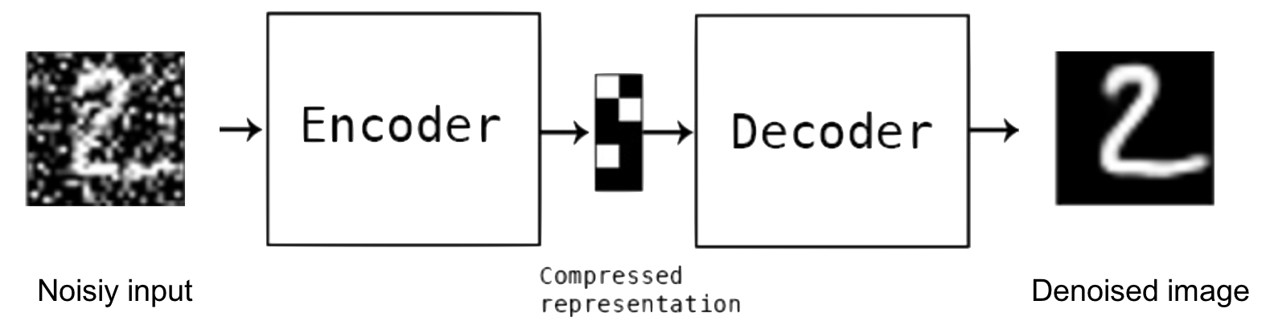
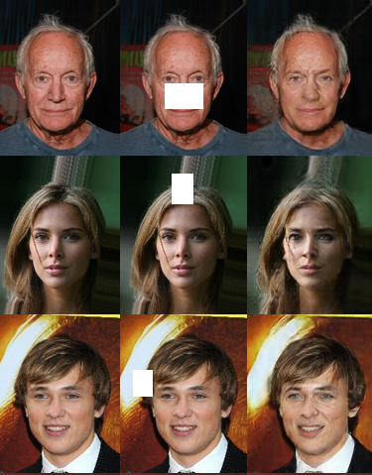
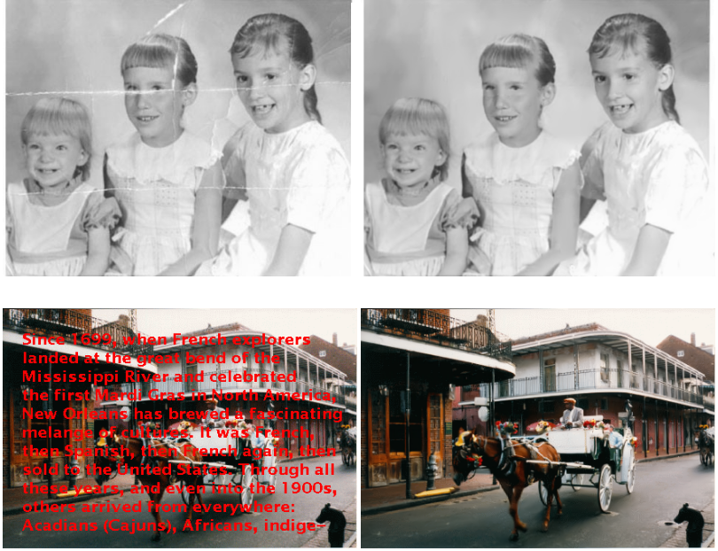
Image denoising
Image inpainting

Slide 32
Training data
Which images are likely in 𝒮?

Slide 33
Which images are likely in 𝒮?

Slide 35
d
k
d
d
x^{T}
=
f(x)^{T}
W₂
W₁

Slide 36
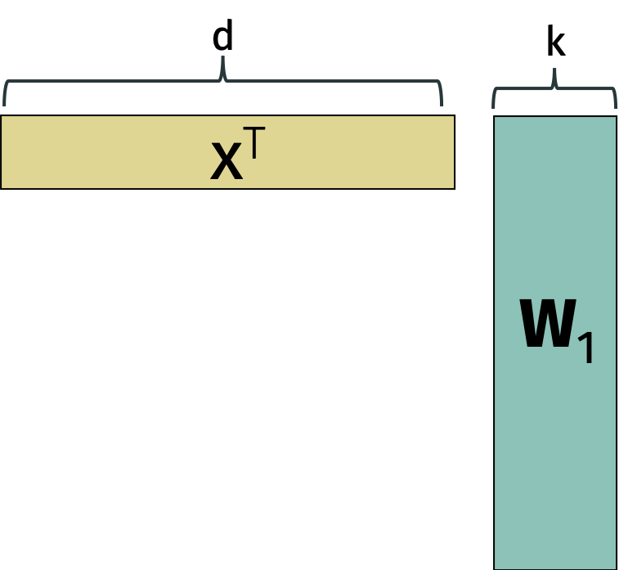
encoder
d
z
=
f(x)^{T}
W₂
k
decoder

Slide 37
d
k
d
d
x₁
f(x₁)
W₂
x₂
f(x₂)
W₁
=
~
X
X
x_{n}
f(x_{n})

Slide 38
k
d
d
z₁
W₂
z₂
=
~
Z= XV_{k}
X
z_{n}

Slide 39
k
d
d
z₁
V_{k}^{T}
z₂
loading
vectors
=
~
Z= XV_{k}
X
z_{n}
principal components

Slide 40
d
k
d
x₁
c₁
V^{T}
x₂
c₂
X
=
C
+
R
x_{n}
c_{n}

Slide 41
=
1
0
U^{T}
U
1
1
0
1
1

